Slide 1
Graduate Education:
The Changing Landscape
October 1, 2021
Association of Texas Graduate Schools

Slide 2
Agenda
Enrollment and Completion Trends
Population Changes
Meeting Student and Workforce Demand
60x30TX Refresh
THECB Resources

Slide 3
Enrollment and Completion Trends

Slide 4
Enrollments in graduate education decreased, driven by a 15% decrease in doctoral programs
 | Fall 2018 | Fall 2020
Master's | 98,353 | 101,207
Doctoral | 42,251 | 36,060
Total | 140,604 | 137,267
Data Source: THECB, CBM 001

Slide 5
Number of doctoral degrees awarded statewide increased by 7%, 2016 to 2020
Data Source: THECB Accountability System, Interactive

Slide 6
Disciplines with most degrees awarded are different at master’s and doctoral levels
Top 10 Master’s Degrees Awarded
Top 10 Doctoral Degrees Awarded
Business, Management, Marketing & Related
Education
Health Professions and Related Programs
Engineering
Computer and Information Sciences & Support
Public Administration & Social Service
Psychology
Biological and Biomedical Sciences
Social Sciences
Mathematics & Statistics
Health Professions & Related Programs
Legal Professions & Studies
Engineering
Education
Biological & Biomedical Sciences
Physical Sciences
Psychology
Agriculture, Agriculture Operations & Related Sci
Social Sciences
Business, Management, Marketing & Related
Data Source: THECB Accountability System, Interactive

Slide 7
Growth potential in doctoral degrees awarded is high for minority populations
 | Master’s |  | Doctoral
Race/Ethnicity | Count | Percent | Count | Percent
African American | 6,616 | 11.7% | 1,073 | 8.7%
Asian | 3,694 | 6.6% | 1,512 | 12.3%
Hispanic | 11,680 | 20.7% | 1,882 | 15.3%
International | 8,754 | 15.5% | 1,917 | 15.5%
Other | 2,435 | 4.3% | 641 | 5.2%
White | 23,182 | 41.1% | 5,310 | 43.0%
Total | 56,361 | 100% | 12,335 | 100%
Data Source: THECB Accountability System, Interactive

Slide 8
Population Changes

Slide 9
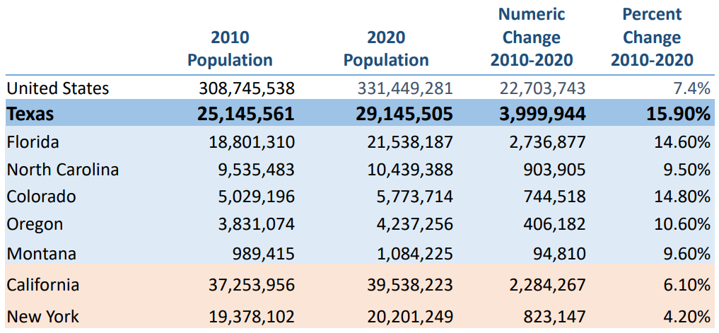
Population growth in Texas outpaced other states
Data Source: U.S. Census Bureau. 2010 and 2020 Census Apportionment File

Slide 10
2020
Demographic Shifts,
2010 to 2020
–
+
+
+
+

Slide 11
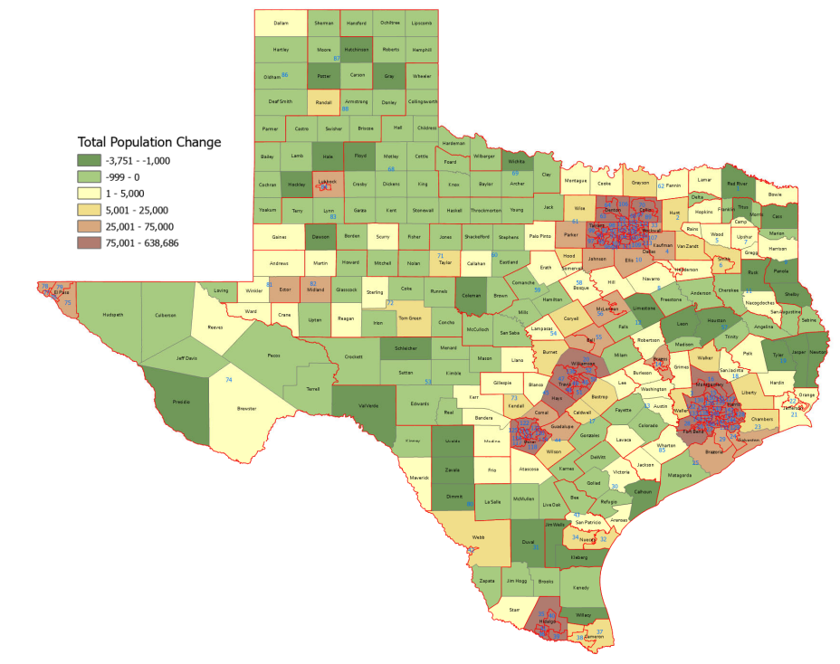
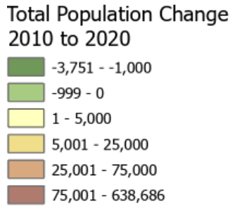
Population growth was not unilateral across the state
56% of counties lost population overall
78% lost NH Whites
62% lost NH Blacks
25% lost Hispanics
19% lost NH Asians
Data Source: US Census Bureau, 2010 and 2020 Census, P.L. 94‐171 Redistricting File

Slide 12
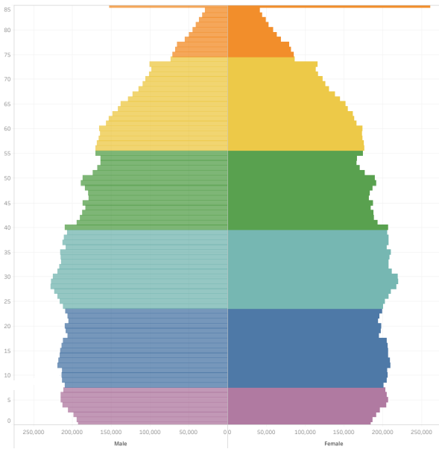
85
80
75
70
65
60
55
50
45
40
35
30
25
20
15
10
5
0
Male
Silent Gen
Boomers
Gen X
Millennials
Gen Z
Gen Alpha
Female
Our population pyramid is more like a stack

Slide 13
High school graduations are projected to grow in Texas over the next 15 years
CA
TX
FL
NY
PA
Data Source: WICHE Knocking at the College Door

Slide 14
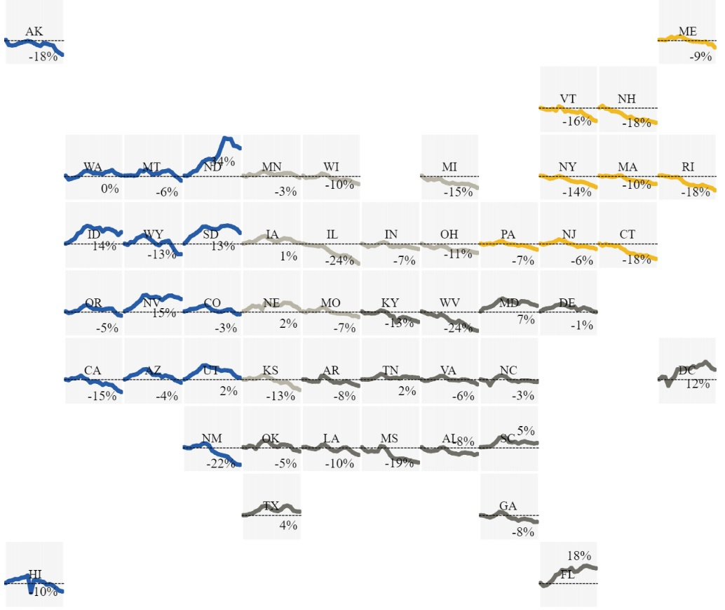
Most states are experiencing a decline in high school graduates

Slide 15
9% of the current U.S. population lives in Texas.
Between 2010 and 2020, the Texas population grew more than any other state.
Growth was concentrated in metropolitan areas.
More than ½ of Texas counties lost population since the last Census, all of them rural.
The percent of Hispanics in our state is near parity to NH Whites.
The bulk of current post-baccalaureate enrollments are Millennials.
Gen Z are already enrolled as graduate students.
Texas is 1 of 13 states that will experience an increase in high school graduates in the next 15+ years.
Demographic Changes – Take-a-ways

Slide 16
Meeting Student
and
Workforce Demand

Slide 17
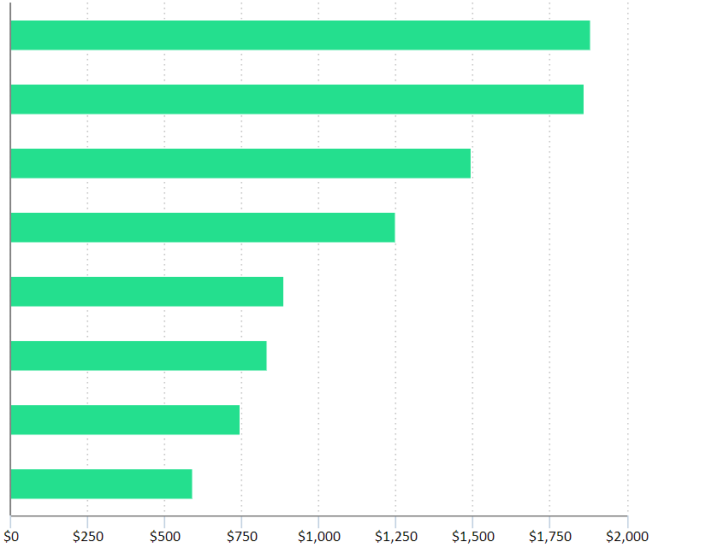
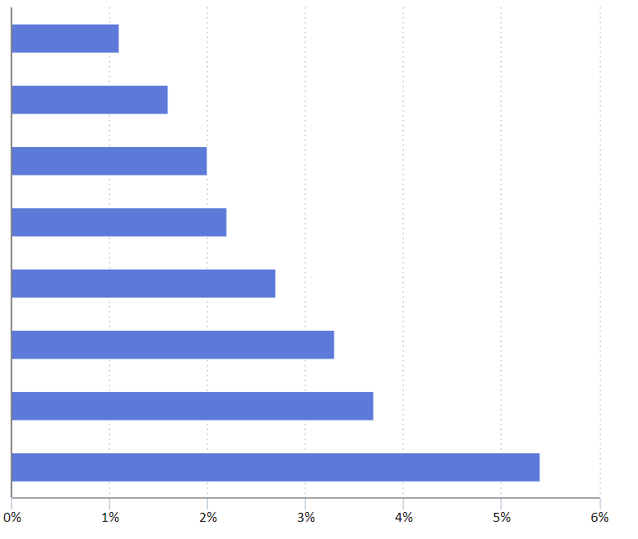
Graduate education has market value
Median usual weekly earnings Unemployment Rate
$1,883
Doctoral Degree
Professional degree
Master’s degree
Bachelor’s degree
Associate’s degree
Some college, no degree
High school diploma
Less than HS diploma
1.1%
$1,861
1.6%
$1,497
2.0%
$1,248
2.2%
$887
2.7%
$833
3.3%
$746
3.7%
$592
5.4%
Data Source: BLS, 2020

Slide 18
Graduate education has market potential
Occupation | Projects openings, 2019-2029 | Median annual wage, 2019 | Typical education needed for entry
Lawyers | 39,900 | $122,960 | Doctoral or professional degree
Educational, guidance, and career counselors and advisors | 33,100 | 57,040 | Master's degree
Health specialties teachers, postsecondary | 26,000 | 97,320 | Doctoral or professional degree
Nurse practitioners | 24,200 | 109,820 | Master's degree
Education administrators, kindergarten through secondary | 20,000 | 96,400 | Master's degree
Healthcare social workers | 19,600 | 56,750 | Master's degree
Postsecondary teachers, all other | 18,900 | 68,970 | Doctoral or professional degree
Instructional coordinators | 17,700 | 66,290 | Master's degree
Physical therapists | 15,200 | 89,440 | Doctoral or professional degree
Speech-language pathologists | 13,700 | 79,120 | Master's degree
5.4%
Data Source: BLS, 2020

Slide 19
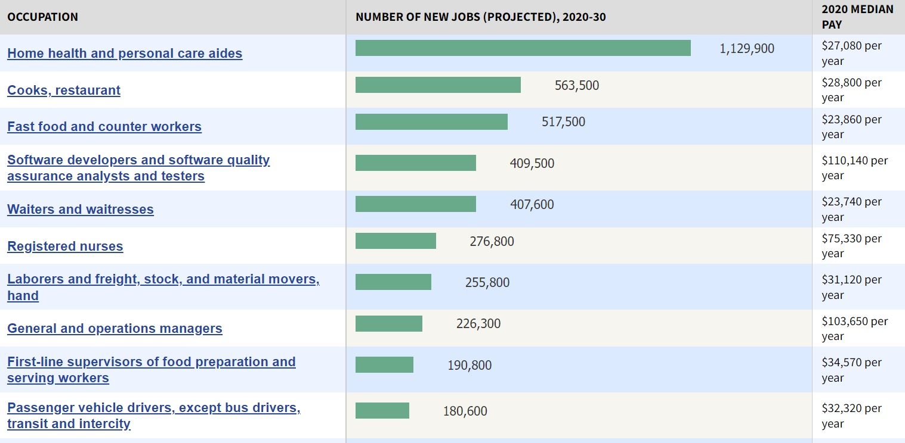
Graduate training and the “Great Resignation”

Slide 20
Economic downturn has not led to boost in higher education enrollments overall
Public Sector | 2019 | 2020 | Numeric  | % Change
Public Universities | 657,985 | 667,046 | 9,061 | 1.38%
Community Colleges | 748,478 | 664,805 | (83,673) | -11.18%
Lamar State Colleges | 9,116 | 9,350 | 234 | 2.57%
TSTC System | 11,694 | 13,756 | 2,062 | 17.63%
Health Related Institutions | 26,169 | 27,024 | 855 | 3.27%
TOTAL | 1,453,442 | 1,381,981 | (71,461) | -4.92%
Data Source: THECB Accountability System

Slide 21
60x30XTX Refresh

Slide 22
The 60x30TX Strategic Plan for Texas Higher Education
60x30TX
Completion
Marketable skills
Student debt
60% of Texans 25-34 with credentials by 2030
550,000 credentials in 2030
Marketable skills for all credentials
60% of first-year wages

Slide 23
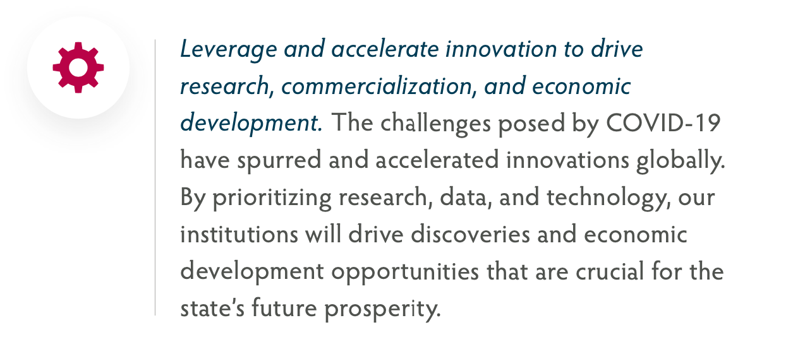
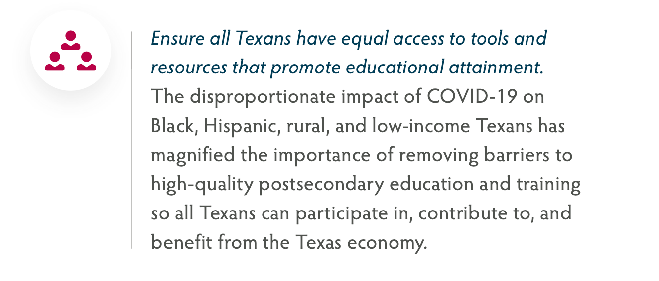
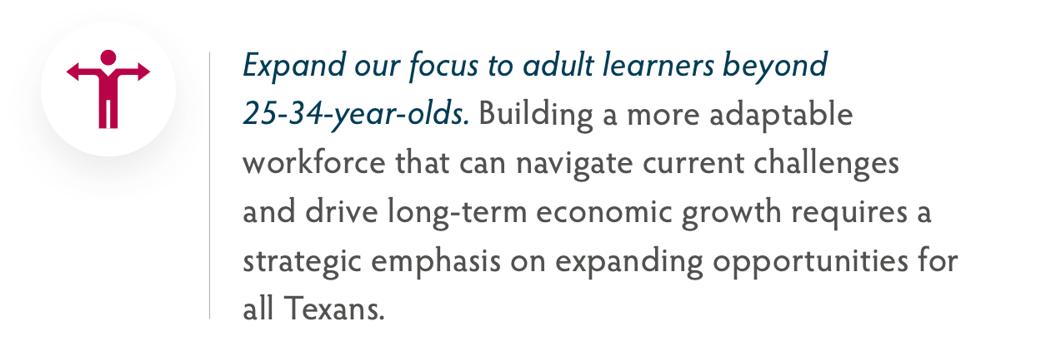
Strengthening the 60x30TX plan
Build on the focus of the original 60x30TX plan to increase postsecondary attainment by developing clear goals that expand the educated workforce and drive economic prosperity.

Slide 24
Research and Development Landscape in Texas
Texas was third in the nation in 2019 in total research expenditures (see next slide)
From 2010 to 2019, Texas held steady at 7% of all U.S. R&D expenditures
Overall, Texas institutions command a large proportion of total U.S. research activity, however, it's diffused over a broader range of institutions than in many other states
In 2019, only two Texas institutions were in the top 25 nationwide by total R&D expenditures:
University of Texas M.D. Anderson at #20
Texas A&M University/Health Science Center at #22

Slide 25
Texas ranked third nationally for total research expenditures
Data Source: National Science Foundation, 2019

Slide 26
THECB Resources

Slide 27
FAQ site is minimal

Slide 28
Expanding Capacity for High-Demand, High-Value Credentials
Texas True | $ 18.75 M
Credentials for the Future | $ 18.75 M
Work Based Learning | $ 5.00 M
Centralized Credential Repository | $ 5.00 M
Community College Cost Analysis | $ 0.70 M
Financial Aid and Enrollment Support
Reskilling Support Grants | $ 6.00 M
Texas Leadership Scholarship Program | $ 7.00 M
Transfer Grants | $ 10.00 M
Student Success Consortium | $ 1.50 M
Advising Resources | $ 4.00 M
My Texas Future
MyTXFuture: Student Engagement | $ 8.50 M
MyTXFuture: Data Analytics | $ 1.25 M
MyTXFuture: Educator Training | $ 0.25 M
GradTX 2.0 Expansion | $ 4.00 M
Data Security & Accessibility | $ 4.00 M
GEER funds

Slide 29
THECB Resources
Accountability System www.txhigheredaccountability.org/acctpublic/
Classification of Instructional Programs (CIP) www.txhighereddata.org/Interactive/CIP/ (Texas)
Degree Program Search www.thecb.state.tx.us/apps/programinventory
Institutional Program Inventory www.thecb.state.tx.us/apps/programinventory

Slide 30
Other Resources
Bureau of Labor Statistics, Occupational Outlook Handbook https://www.bls.gov/ooh/
Burning Glass www.burning-glass.com
Department of State Health Services, Health Professions Fact Sheets http://www.dshs.texas.gov/chs/hprc/health.shtm
Economic Development and Employer Planning System www.edeps.org
National Center for Education Statistics, Integrated Post-Secondary Education Data System (IPEDS) https://nces.ed.gov/
and https://nces.ed.gov/ipeds/cipcode/
National Science Foundation, WebCASPAR: Integrated Science and Engineering Resources Data System
https://ncsesdata.nsf.gov/webcaspar/
Texas Administrative Code https://texreg.sos.state.tx.us/public/readtac$ext.ViewTAC?tac_view=4&ti=19&pt=1&ch=5
Texas Health Professions Regulatory Boards www.hpc.texas.gov/agencies/ (Health Professions)
Texas Labor Market Information https://texaslmi.com/
Texas Workforce Commission www.twc.state.tx.us

Slide 31
Questions

Slide 32
Ray Martinez, J.D.
Deputy Commissioner, Academic Affairs and Workforce Education
Ray.Martinez@highered.texas.gov

